Slide 1



Audio Report
View in Power BI
Last data refresh:
2/25/2026 10:51:31 AM UTC
Downloaded at:
2/25/2026 11:14:43 AM UTC

Slide 2
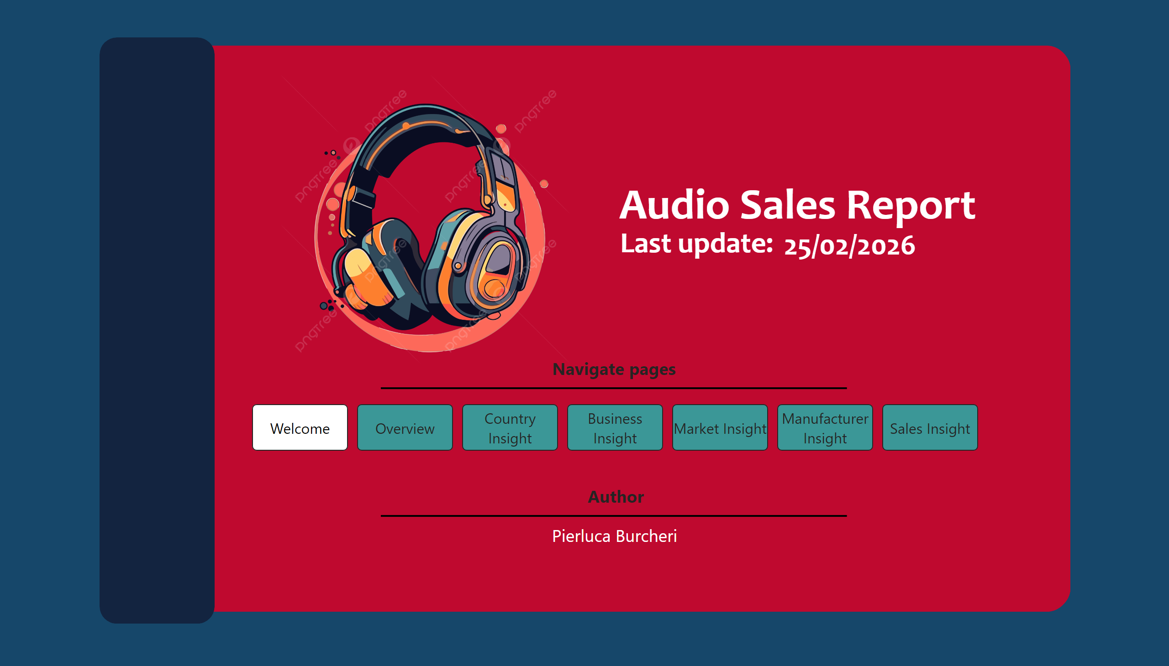
Welcome
Notes:
card
No alt text provided
textbox
No alt text provided
textbox
No alt text provided
pageNavigator
No alt text provided
shape
No alt text provided
textbox
No alt text provided
textbox
No alt text provided
shape
No alt text provided
shape
No alt text provided
textbox
No alt text provided
shape
No alt text provided
image
No alt text provided

Slide 3
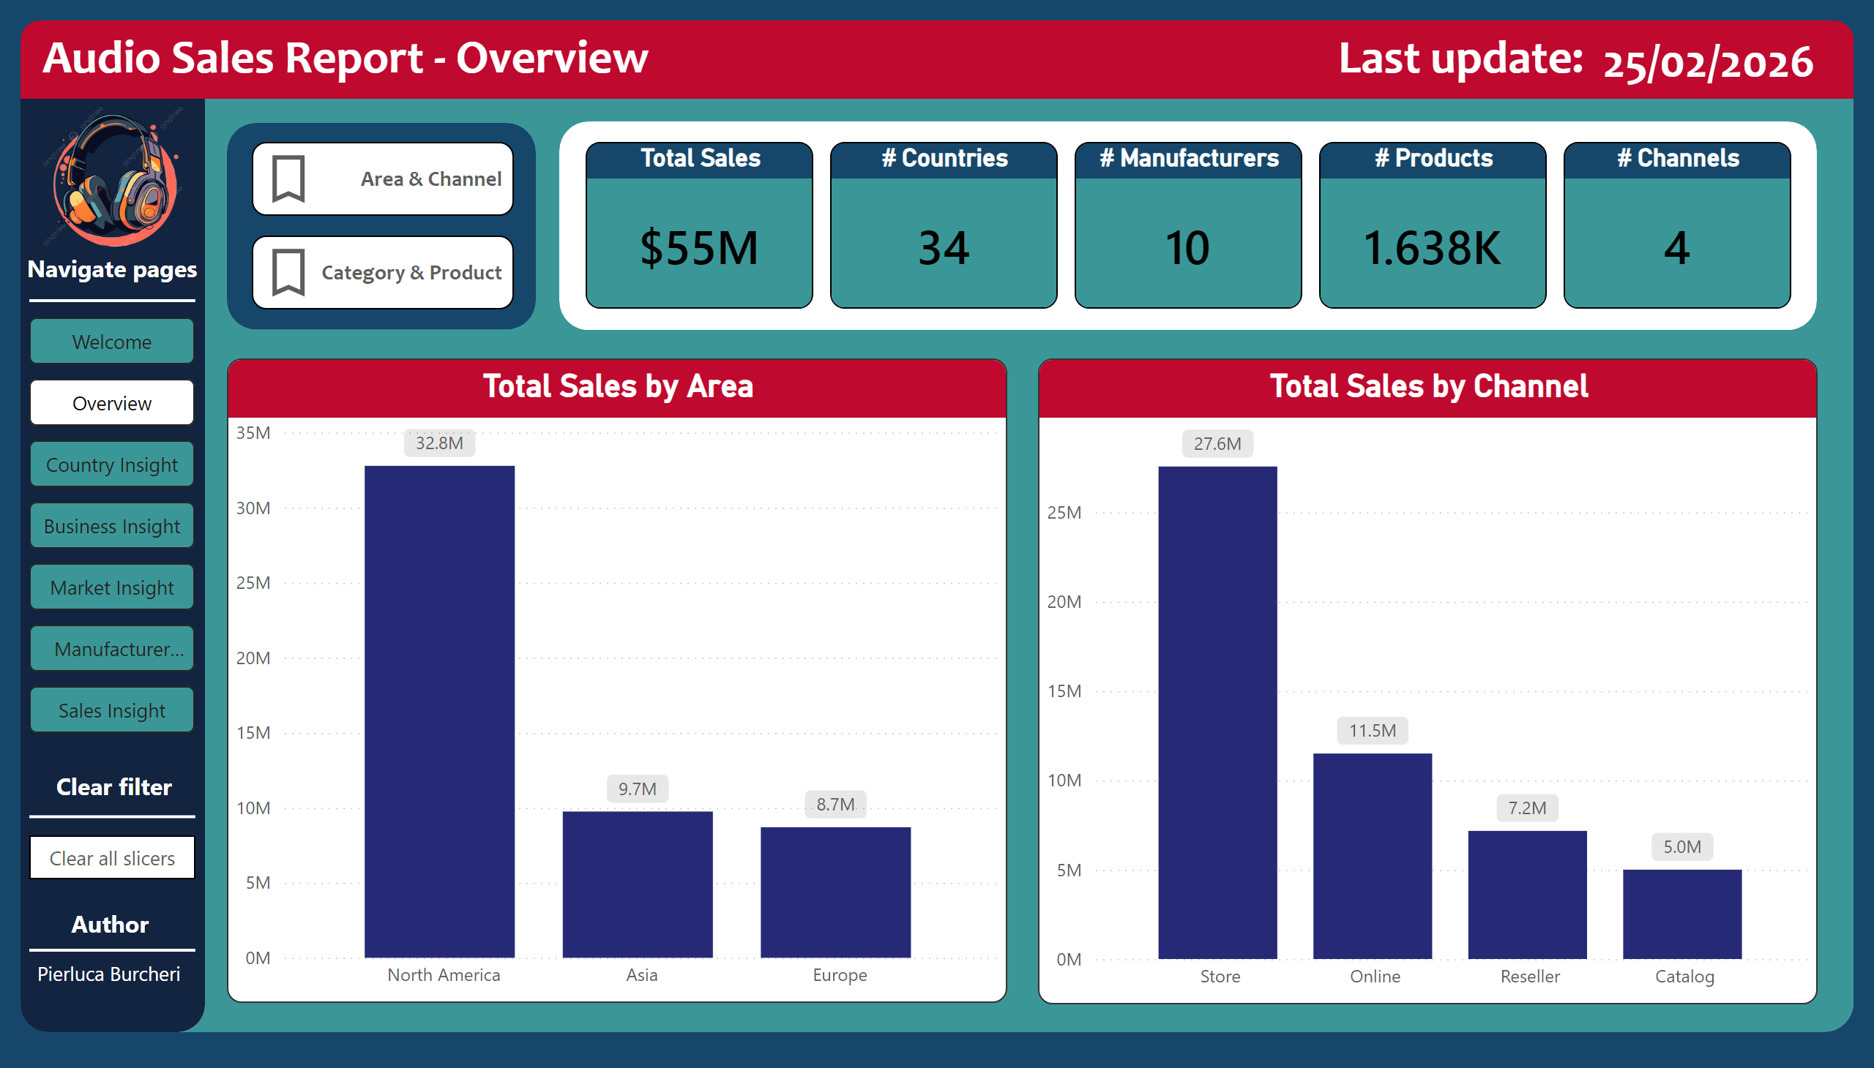
Overview
Notes:
Total Sales by Area
No alt text provided
textbox
No alt text provided
pageNavigator
No alt text provided
shape
No alt text provided
shape
No alt text provided
shape
No alt text provided
textbox
No alt text provided
shape
No alt text provided
Total Sales
No alt text provided
# Countries
No alt text provided
# Manufacturers
No alt text provided
# Products
No alt text provided
shape
No alt text provided
# Channels
No alt text provided
textbox
No alt text provided
card
No alt text provided
actionButton
No alt text provided
textbox
No alt text provided
shape
No alt text provided
shape
No alt text provided
textbox
No alt text provided
textbox
No alt text provided
columnChart
No alt text provided
barChart
No alt text provided
shape
No alt text provided
actionButton
No alt text provided
actionButton
No alt text provided
image
No alt text provided
Total Sales by Channel
No alt text provided

Slide 4
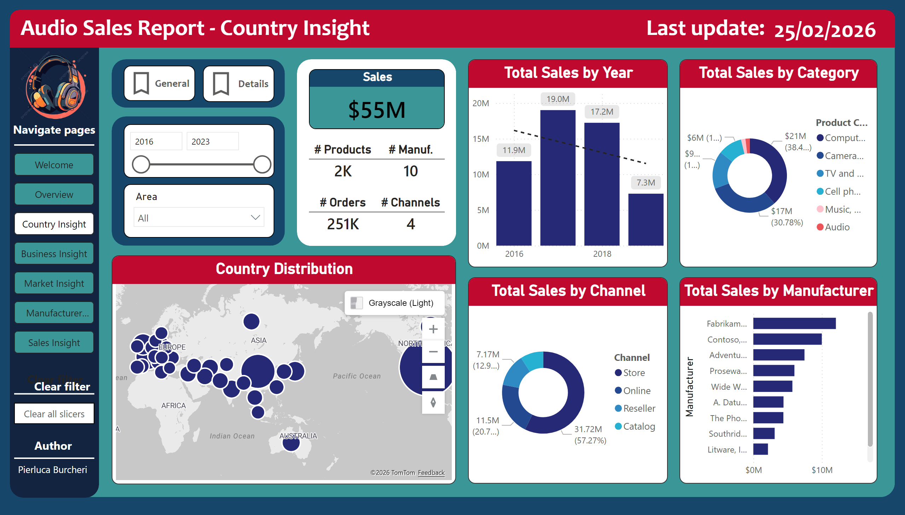
Country Insight
Notes:
textbox
No alt text provided
shape
No alt text provided
shape
No alt text provided
textbox
No alt text provided
card
No alt text provided
Country Distribution
No alt text provided
Total Sales by Year
No alt text provided
shape
No alt text provided
textbox
No alt text provided
pivotTable
No alt text provided
actionButton
No alt text provided
actionButton
No alt text provided
shape
No alt text provided
image
No alt text provided
textbox
No alt text provided
shape
No alt text provided
actionButton
No alt text provided
textbox
No alt text provided
shape
No alt text provided
shape
No alt text provided
textbox
No alt text provided
textbox
No alt text provided
pageNavigator
No alt text provided
Sales
No alt text provided
# Products
No alt text provided
# Manuf.
No alt text provided
shape
No alt text provided
# Orders
No alt text provided
# Channels
No alt text provided
Total Sales by Channel
No alt text provided
Total Sales by Category
No alt text provided
Total Sales by Manufacturer
No alt text provided
slicer
No alt text provided
slicer
No alt text provided
shape
No alt text provided

Slide 5
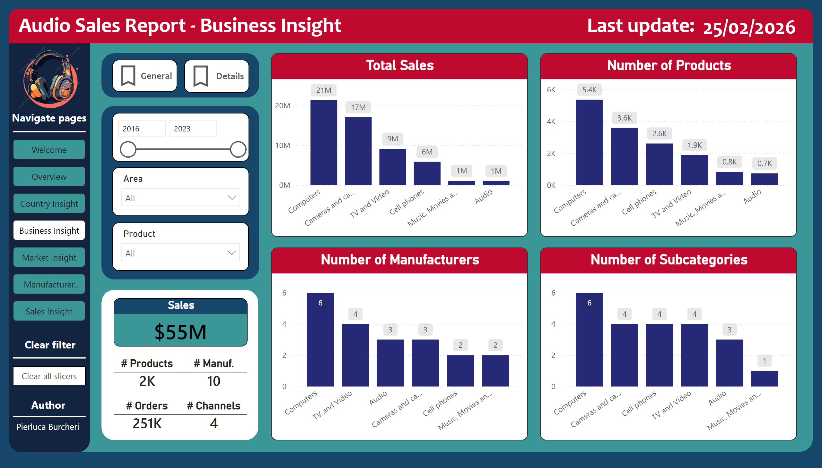
Business Insight
Notes:
textbox
No alt text provided
shape
No alt text provided
shape
No alt text provided
textbox
No alt text provided
card
No alt text provided
shape
No alt text provided
Total Sales
No alt text provided
pivotTable
No alt text provided
image
No alt text provided
textbox
No alt text provided
shape
No alt text provided
actionButton
No alt text provided
textbox
No alt text provided
shape
No alt text provided
shape
No alt text provided
textbox
No alt text provided
textbox
No alt text provided
pageNavigator
No alt text provided
Number of Subcategories
No alt text provided
Number of Products
No alt text provided
Number of Manufacturers
No alt text provided
actionButton
No alt text provided
actionButton
No alt text provided
shape
No alt text provided
slicer
No alt text provided
slicer
No alt text provided
shape
No alt text provided
# Channels
No alt text provided
# Orders
No alt text provided
# Manuf.
No alt text provided
# Products
No alt text provided
Sales
No alt text provided
shape
No alt text provided
slicer
No alt text provided

Slide 6
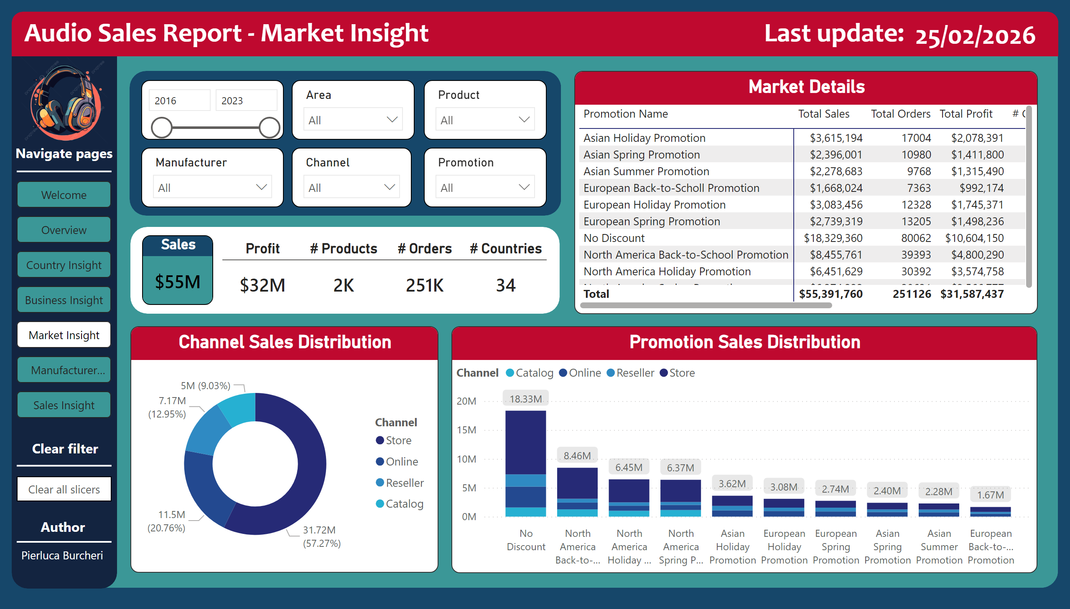
Market Insight
Notes:
textbox
No alt text provided
shape
No alt text provided
shape
No alt text provided
textbox
No alt text provided
card
No alt text provided
Market Details
No alt text provided
shape
No alt text provided
slicer
No alt text provided
slicer
No alt text provided
slicer
No alt text provided
shape
No alt text provided
slicer
No alt text provided
slicer
No alt text provided
slicer
No alt text provided
Channel Sales Distribution
No alt text provided
Sales
No alt text provided
shape
No alt text provided
image
No alt text provided
textbox
No alt text provided
shape
No alt text provided
actionButton
No alt text provided
textbox
No alt text provided
shape
No alt text provided
shape
No alt text provided
textbox
No alt text provided
textbox
No alt text provided
pageNavigator
No alt text provided
Promotion Sales Distribution
No alt text provided
# Countries
No alt text provided
# Orders
No alt text provided
# Products
No alt text provided
Profit
No alt text provided

Slide 7
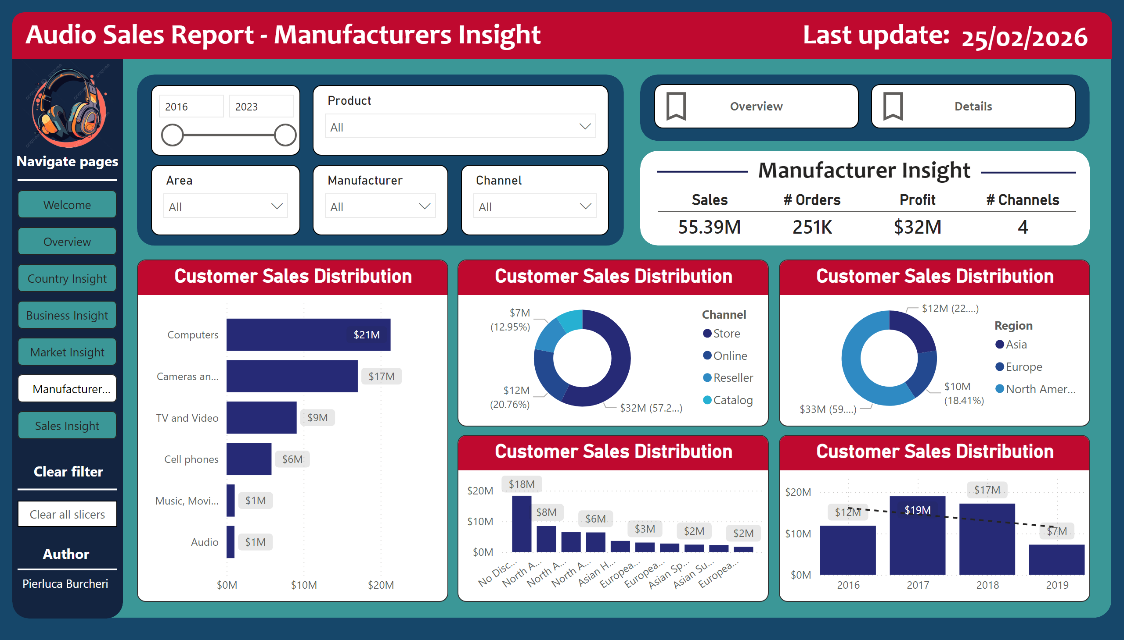
Manufacturer Insight
Notes:
textbox
No alt text provided
shape
No alt text provided
shape
No alt text provided
textbox
No alt text provided
card
No alt text provided
pivotTable
No alt text provided
shape
No alt text provided
slicer
No alt text provided
slicer
No alt text provided
slicer
No alt text provided
slicer
No alt text provided
shape
No alt text provided
slicer
No alt text provided
Customer Sales Distribution
No alt text provided
shape
No alt text provided
shape
No alt text provided
textbox
No alt text provided
Sales
No alt text provided
# Orders
No alt text provided
shape
No alt text provided
Profit
No alt text provided
# Channels
No alt text provided
image
No alt text provided
textbox
No alt text provided
shape
No alt text provided
actionButton
No alt text provided
textbox
No alt text provided
shape
No alt text provided
shape
No alt text provided
textbox
No alt text provided
textbox
No alt text provided
pageNavigator
No alt text provided
Customer Sales Distribution
No alt text provided
Customer Sales Distribution
No alt text provided
Customer Sales Distribution
No alt text provided
Customer Sales Distribution
No alt text provided
shape
No alt text provided
actionButton
No alt text provided
actionButton
No alt text provided

Slide 8
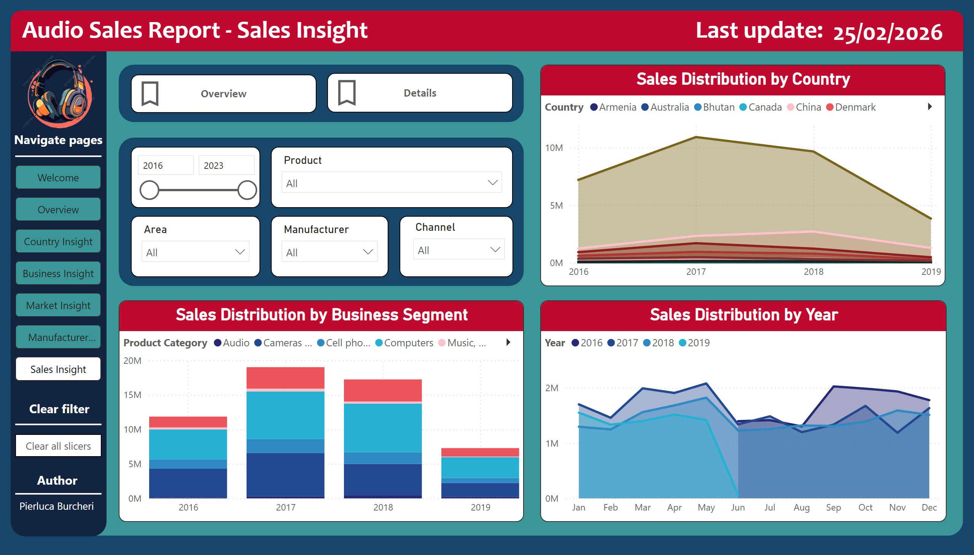
Sales Insight
Notes:
textbox
No alt text provided
shape
No alt text provided
shape
No alt text provided
textbox
No alt text provided
card
No alt text provided
shape
No alt text provided
Sales Distribution by Business Segment
No alt text provided
Sales Distribution by Year
No alt text provided
Sales Distribution by Country
No alt text provided
pivotTable
No alt text provided
pivotTable
No alt text provided
pivotTable
No alt text provided
slicer
No alt text provided
slicer
No alt text provided
slicer
No alt text provided
slicer
No alt text provided
shape
No alt text provided
slicer
No alt text provided
shape
No alt text provided
actionButton
No alt text provided
actionButton
No alt text provided
image
No alt text provided
textbox
No alt text provided
shape
No alt text provided
actionButton
No alt text provided
textbox
No alt text provided
shape
No alt text provided
shape
No alt text provided
textbox
No alt text provided
textbox
No alt text provided
pageNavigator
No alt text provided

